Slide 1
BLM206 Mikroişlemci Sistemleri
Chapter 4
ARM Arithmetic and Logic Instructions
M.Aydin - 2018

Slide 2
Overview: Arithmetic and Logic Instructions
Shift
LSL (logic shift left), LSR (logic shift right), ASR (arithmetic shift right), ROR (rotate right), RRX (rotate right with extend)
Logic
AND (bitwise and), ORR (bitwise or), EOR (bitwise exclusive or), ORN (bitwise or not), MVN (move not)
Bit set/clear
BFC (bit field clear), BFI (bit field insert), BIC (bit clear), CLZ (count leading zeroes)
Bit/byte reordering
RBIT (reverse bit order in a word), REV (reverse byte order in a word), REV16 (reverse byte order in each half-word independently), REVSH (reverse byte order in each half-word independently)
Addition
ADD, ADC (add with carry)
Subtraction
SUB, RSB (reverse subtract), SBC (subtract with carry)
Multiplication
MUL (multiply), MLA (multiply-accumulate), MLS (multiply-subtract), SMULL (signed long multiply-accumulate), SMLAL (signed long multiply-accumulate), UMULL (unsigned long multiply-subtract), UMLAL (unsigned long multiply-subtract)
Division
SDIV (signed), UDIV (unsigned)
Saturation
SSAT (signed), USAT (unsigned)
Sign extension
SXTB (signed), SXTH, UXTB, UXTH
Bit field extract
SBFX (signed), UBFX (unsigned)
Syntax
<Operation>{<cond>}{S} Rd, Rn, Operand2
Notes:
BIC bit clear
ORR bit set
AND bit mask
EOR bit invert
Comparisons produce no results - just set condition codes.
CMP like SUB
CMN like ADD (subtract of a negative number is the same as add)
TST like AND
TEQ like EOR (eor of identical numbers gives result of zero)
Generally single-cycle execution (except write to PC and register-controlled shift). Mention ARM NOP & Thumb NOP.
Explain RSB and RSC which do subtract in other order (e.g. y-x not x-y)
Does not include multiply (separate instr format). No divide - compiler uses run-time library or barrel shifter to perform division.
Can combine “S” bit with conditional execution, e.g.
ADDEQS r0, r1, r2

Slide 3
Example: Add
Unified Assembler Language (UAL) Syntax
ADD r1, r2, r3 ; r1 = r2 + r3
ADD r1, r2, #4 ; r1 = r2 + 4
Traditional Thumb Syntax
ADD r1, r3 ; r1 = r1 + r3
ADD r1, #15 ; r1 = r1 + 15

Slide 4
Commonly Used Arithmetic Operations
ADD {Rd,} Rn, Op2 | Add. Rd ← Rn + Op2
ADC {Rd,} Rn, Op2 | Add with carry. Rd ← Rn + Op2 + Carry
SUB {Rd,} Rn, Op2 | Subtract. Rd ← Rn - Op2
SBC {Rd,} Rn, Op2 | Subtract with carry. Rd ← Rn - Op2 + Carry - 1
RSB {Rd,} Rn, Op2 | Reverse subtract. Rd ← Op2 - Rn
MUL {Rd,} Rn, Rm | Multiply. Rd ← (Rn × Rm)[31:0]
MLA Rd, Rn, Rm, Ra | Multiply with accumulate. Rd ← (Ra + (Rn × Rm))[31:0]
MLS Rd, Rn, Rm, Ra | Multiply and subtract, Rd ← (Ra – (Rn × Rm))[31:0]
SDIV {Rd,} Rn, Rm | Signed divide. Rd ← Rn / Rm
UDIV {Rd,} Rn, Rm | Unsigned divide. Rd ← Rn / Rm
SSAT Rd, #n, Rm {,shift #s} | Signed saturate
USAT Rd, #n, Rm {,shift #s} | Unsigned saturate

Slide 5
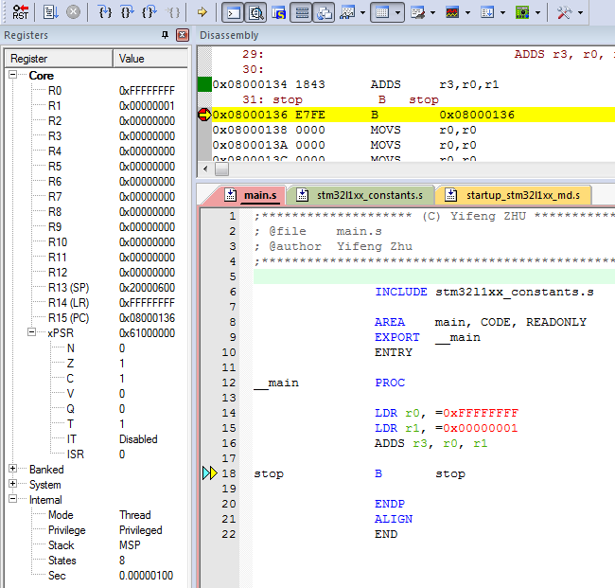
Example: S: Set Condition Flags
start
LDR r0, =0xFFFFFFFFF
LDR r1, =0x00000001
ADDS r0, r0, r1
stop B stop
For most instructions, we can add a suffix S to update the NZCV bits of the APSR register.
In this example, the Z and C bits are set.

Slide 6
Program Status Register
Application PSR (APSR), Interrupt PSR (IPSR), Execution PSR (EPSR)
31
30
29
28
27
26
25
24
23
22
21
20
19
18
17
16
15
14
13
12
11
10
9
8
7
6
5
4
3
2
1
0
APSR
N
Z
C
V
Q
Reserved
GE
Reserved
IPSR
Reserved
ISR number
EPSR
ICI/IT
T
Reserved
ICI/IT
Note:
GE flags are only available on Cortex-M4 and M7

Slide 7
Program Status Register
Application PSR (APSR), Interrupt PSR (IPSR), Execution PSR (EPSR)
31
30
29
28
27
26
25
24
23
22
21
20
19
18
17
16
15
14
13
12
11
10
9
8
7
6
5
4
3
2
1
0
APSR
N
Z
C
V
Q
Reserved
GE
Reserved
IPSR
Reserved
ISR number
EPSR
ICI/IT
T
Reserved
ICI/IT
Combine them together into one register (PSR)
PSR
N
Z
C
V
Q
ICI/IT
T
Reserved
GE
Reserved
ICI/IT
ISR number
Note:
GE flags are only available on Cortex-M4 and M7
Use PSR in code

Slide 8
Example: 64-bit Addition
Most-significant (Upper) 32 bits
Least-significant (Lower) 32 bits
0 0 0 0 0 0 0 2 F F F F F F F F
0 0 0 0 0 0 0 4 0 0 0 0 0 0 0 1
0 0 0 0 0 0 0 7 0 0 0 0 0 0 0 0
+
Carry out
A register can only store 32 bits
A 64-bit integer needs two registers
Split 64-bit addition into two 32-bit additions

Slide 9
Example: 64-bit Addition
start
; C = A + B
; Two 64-bit integers A (r1,r0) and B (r3, r2).
; Result C (r5, r4)
; A = 00000002FFFFFFFF
; B = 0000000400000001
LDR r0, =0xFFFFFFFF ; A’s lower 32 bits
LDR r1, =0x00000002 ; A’s upper 32 bits
LDR r2, =0x00000001 ; B’s lower 32 bits
LDR r3, =0x00000004 ; B’s upper 32 bits
; Add A and B
ADDS r4, r2, r0 ; C[31..0] = A[31..0] + B[31..0], update Carry
ADC r5, r3 r1 ; C[64..32] = A[64..32] + B[64..32] + Carry
stop B stop

Slide 10
Example: 64-bit Subtraction
start
; C = A - B
; Two 64-bit integers A (r1,r0) and B (r3, r2).
; Result C (r5, r4)
; A = 00000002FFFFFFFF
; B = 0000000400000001
LDR r0, =0xFFFFFFFF ; A’s lower 32 bits
LDR r1, =0x00000002 ; A’s upper 32 bits
LDR r2, =0x00000001 ; B’s lower 32 bits
LDR r3, =0x00000004 ; B’s upper 32 bits
; Subtract B from A
SUBS r4, r0, r2 ; C[31..0]= A[31..0] - B[31..0], update Carry
SBC r5, r1, r3 ; C[64..32]= A[64..32] - B[64..32] - Carry
stop B stop

Slide 11
Example: Short Multiplication and Division
; MUL: Signed multiply
MUL r6, r4, r2 ; r6 = LSB32( r4 × r2 )
; UMUL: Unsigned multiply
UMUL r6, r4, r2 ; r6 = LSB32( r4 × r2 )
; MLA: Multiply with accumulation
MLA r6, r4, r1, r0 ; r6 = LSB32( r4 × r1 ) + r0
; MLS: Multiply with subtract
MLS r6, r4, r1, r0 ; r6 = LSB32( r4 × r1 ) - r0

Slide 12
Example: Long Multiplication
UMULL RdLo, RdHi, Rn, Rm | Unsigned long multiply. RdHi,RdLo ← unsigned(Rn × Rm)
SMULL RdLo, RdHi, Rn, Rm | Signed long multiply. RdHi,RdLo ← signed(Rn × Rm)
UMLAL RdLo, RdHi, Rn, Rm | Unsigned multiply with accumulate. RdHi,RdLo ← unsigned(RdHi,RdLo + Rn × Rm)
SMLAL RdLo, RdHi, Rn, Rm | Signed multiply with accumulate. RdHi,RdLo ← signed(RdHi,RdLo + Rn × Rm)
UMULL r3, r4, r0, r1 ; r4:r3 = r0 × r1, r4 = MSB bits, r3 = LSB bits
SMULL r3, r4, r0, r1 ; r4:r3 = r0 × r1
UMLAL r3, r4, r0, r1 ; r4:r3 = r4:r3 + r0 × r1
SMLAL r3, r4, r0, r1 ; r4:r3 = r4:r3 + r0 × r1

Slide 13
Bitwise Logic
AND {Rd,} Rn, Op2 | Bitwise logic AND. Rd ← Rn & operand2
ORR {Rd,} Rn, Op2 | Bitwise logic OR. Rd ← Rn | operand2
EOR {Rd,} Rn, Op2 | Bitwise logic exclusive OR. Rd ← Rn ^ operand2
ORN {Rd,} Rn, Op2 | Bitwise logic NOT OR. Rd ← Rn | (NOT operand2)
BIC {Rd,} Rn, Op2 | Bit clear. Rd ← Rn & NOT operand2
BFC Rd, #lsb, #width | Bit field clear. Rd[(width+lsb–1):lsb] ← 0
BFI Rd, Rn, #lsb, #width | Bit field insert. Rd[(width+lsb–1):lsb] ← Rn[(width-1):0]
MVN Rd, Op2 | Move NOT, logically negate all bits. Rd ← 0xFFFFFFFF EOR Op2

Slide 14
Example: AND r2, r0, r1
32 bits
r0
1 1 0 1 0 1 0 1 0 1 0 1 0 1 0 1 0 1 0 1 0 1 0 1 0 1 0 1 0 1 0 1
1 0 1 0 1 0 1 0 1 0 1 0 1 0 1 1 1 0 1 0 1 0 1 0 1 0 1 0 1 0 1 1
1 0 0 0 0 0 0 0 0 0 0 0 0 0 0 1 0 0 0 0 0 0 0 0 0 0 0 0 0 0 0 1
r1
r2
Bit-wise Logic AND

Slide 15
Example: ORR r2, r0, r1
32 bits
r0
1 1 0 1 0 1 0 1 0 1 0 1 0 1 0 1 0 1 0 1 0 1 0 1 0 1 0 1 0 1 0 1
1 0 1 0 1 0 1 0 1 0 1 0 1 0 1 1 1 0 1 0 1 0 1 0 1 0 1 0 1 0 1 1
1 1 1 1 1 1 1 1 1 1 1 1 1 1 1 1 1 1 1 1 1 1 1 1 1 1 1 1 1 1 1 1
r1
r2
Bit-wise Logic OR

Slide 16
Example: BIC r2, r0, r1
Bit Clear
r2 = r0 & NOT r1
Step 1:
r1
0 0 0 0 0 0 0 0 0 0 0 0 0 0 0 0 0 0 0 0 0 0 0 0 0 0 0 0 1 1 1 1
NOT r1
1 1 1 1 1 1 1 1 1 1 1 1 1 1 1 1 1 1 1 1 1 1 1 1 1 1 1 1 0 0 0 0
Step 2:
r0
1 1 1 1 1 1 1 1 1 1 1 1 1 1 1 1 1 1 1 1 1 1 1 1 1 1 1 1 1 1 1 1
1 1 1 1 1 1 1 1 1 1 1 1 1 1 1 1 1 1 1 1 1 1 1 1 1 1 1 1 0 0 0 0
1 1 1 1 1 1 1 1 1 1 1 1 1 1 1 1 1 1 1 1 1 1 1 1 1 1 1 1 0 0 0 0
NOT r1
r2

Slide 17
Example: BFC and BFI
Bit Field Clear (BFC) and Bit Field Insert (BFI).
Syntax
BFC Rd, #lsb, #width
BFI Rd, Rn, #lsb, #width
Examples:
BFC R4, #8, #12
; Clear bit 8 to bit 19 (12 bits) of R4 to 0
BFI R9, R2, #8, #12
; Replace bit 8 to bit 19 (12 bits) of R9 with bit 0 to bit 11 from R2.

Slide 18
Bit Operators (&, |, ~) vs Boolean Operators (&& ,||, !)
A && B | Boolean and | A & B | Bitwise and
A||B | Boolean or | A|B | Bitwise or
!B | Boolean not | ~B | Bitwise not
The Boolean operators perform word-wide operations, not bitwise.
For example,
“0x10 & 0x01” = 0x00, but “0x10 && 0x01” = 0x01.
“~0x01” = 0xFFFFFFFE, but “!0x01” = 0x00.

Slide 19
Check a Bit in C or Java
bit = a & (1<<k)
Example: k = 5
a
a₇ | a₆ | a₅ | a₄ | a₃ | a₂ | a₁ | a₀
0 | 0 | 1 | 0 | 0 | 0 | 0 | 0
0 | 0 | a₅ | 0 | 0 | 0 | 0 | 0
1 << k
a & (1<<k)

Slide 20
Set a Bit in C or Java
a |= (1 << k)
or
a = a | (1 << k)
Example: k = 5
a
a₇ | a₆ | a₅ | a₄ | a₃ | a₂ | a₁ | a₀
0 | 0 | 1 | 0 | 0 | 0 | 0 | 0
a₇ | a₆ | 1 | a₄ | a₃ | a₂ | a₁ | a₀
1 << k
a | (1 << k)

Slide 21
Clear a Bit in C or Java
a &= ~(1<<k)
Example: k = 5
a
a₇ | a₆ | a₅ | a₄ | a₃ | a₂ | a₁ | a₀
1 | 1 | 0 | 1 | 1 | 1 | 1 | 1
a₇ | a₆ | 0 | a₄ | a₃ | a₂ | a₁ | a₀
~(1 << k)
a & ~(1<<k)

Slide 22
Toggle a Bit in C or Java
Without knowing the initial value, a bit can be toggled by XORing it with a “1”
a ^= 1<<k
Example: k = 5
a
a₇ | a₆ | a₅ | a₄ | A₃ | a₂ | a₁ | a₀
0 | 0 | 1 | 0 | 0 | 0 | 0 | 0
a₇ | a₆ | NOT(a₅) | A₄ | a₃ | a₂ | a₁ | a₀
1 << k
a ^= 1<<k
a₅ | 1 | a₅⊕1
0 | 1 | 1
1 | 1 | 0
Truth table of Exclusive OR with one
Notes:
A bit can be ‘toggled’ (changed) – without knowing its initial value – by XORing it with a “1”.

Slide 23
Data Movement
MOV | Rd ← operand2
MVN | Rd ← NOT operand2
MRS Rd, spec_reg | Move from special register to general register
MSR spec_reg, Rm | Move from general register to special register
MOV r4, r5 ; Copy r5 to r4
MVN r4, r5 ; r4 = bitwise logical NOT of r5
MOV r1, r2, LSL #3 ; r1 = r2 << 3
MOV r0, PC ; Copy PC (r15) to r0
MOV r1, SP ; Copy SP (r14) to r1

Slide 24
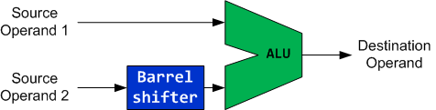
Barrel Shifter
The second operand of ALU has a special hardware called Barrel shifter
Example:
ADD r1, r0, r0, LSL #3 ; r1 = r0 + r0 << 3 = 9 × r0

Slide 25





The Barrel Shifter
Logical Shift Left (LSL)
Arithmetic Shift Right (ASR)
Logical Shift Right (LSR)
Rotate Right (ROR)
Rotate Right Extended (RRX)
Why is there rotate right but no rotate left?
Rotate left can be replaced by a rotate right with a different rotate offset.

Slide 26
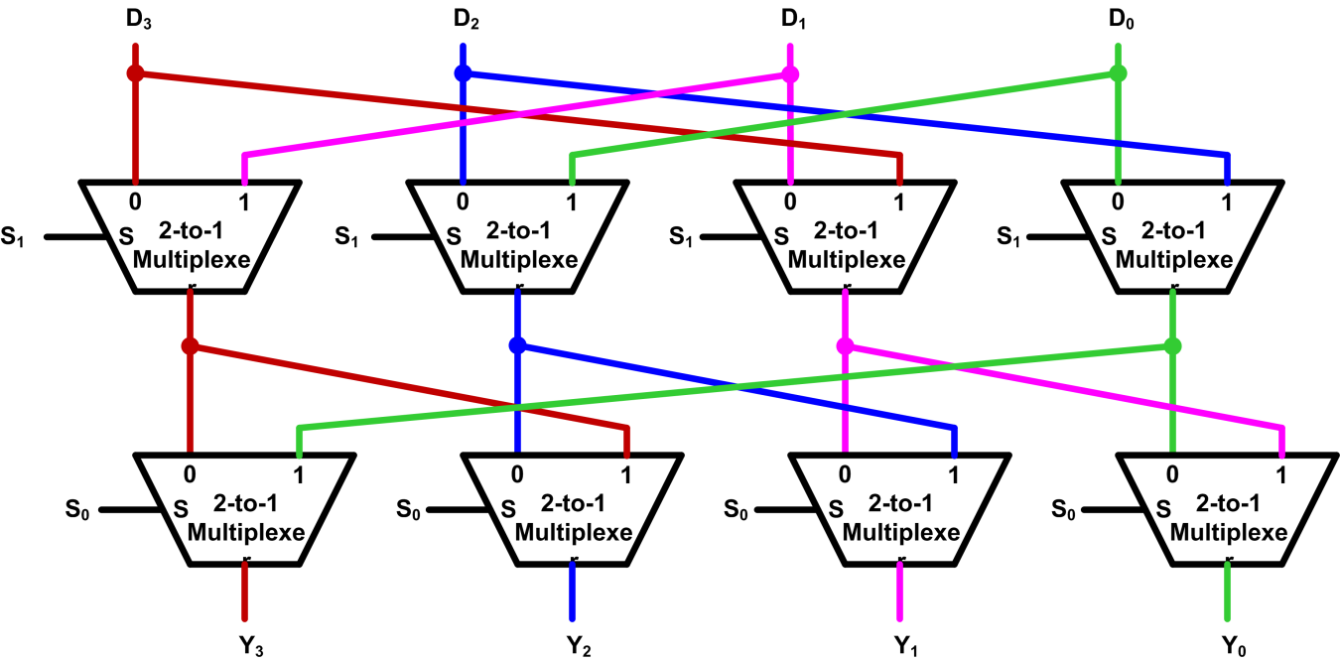
Implementation of Barrel Shifter
Typically, Barrel shifters are implemented as a cascade of parallel 2-to-1 multiplexers.
S₁ | S₀ | Y₃ | Y₂ | Y₁ | Y₀
0 | 0 | D₃ | D₂ | D₁ | D₀
0 | 1 | D₀ | D₃ | D₂ | D₁
1 | 0 | D₁ | D₀ | D₃ | D₂
1 | 1 | D₂ | D₁ | D₀ | D₃
Example four-bit Barrel shifter that performs rotate right

Slide 27
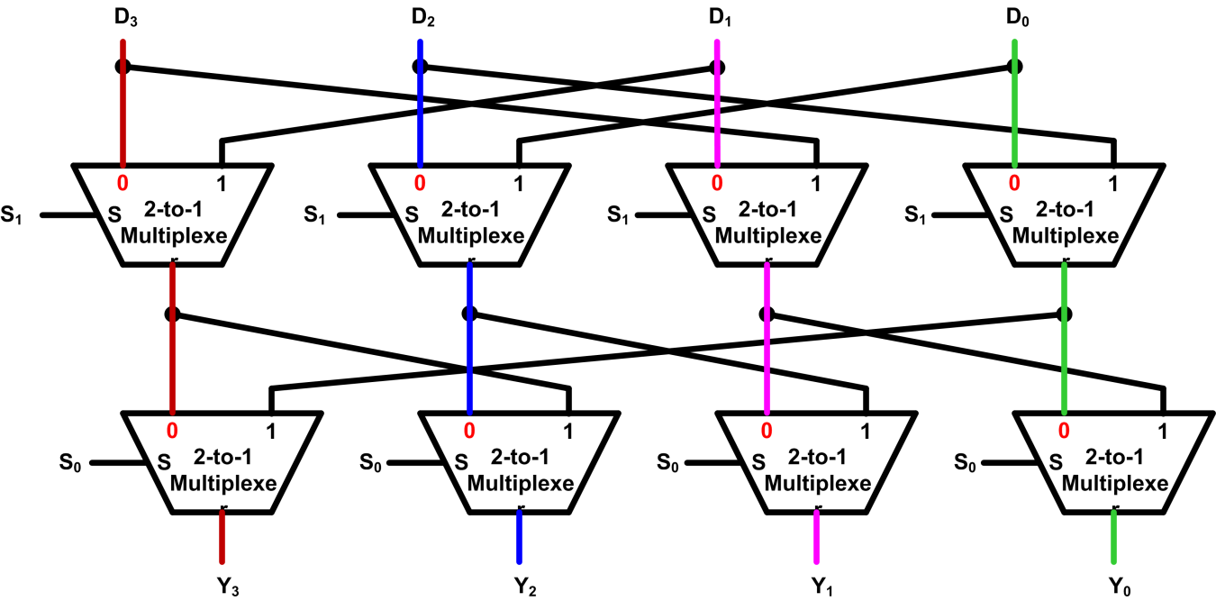
Implementation of Barrel Shifter
Example: S₁S₀ = 00
S₁ | S₀ | Y₃ | Y₂ | Y₁ | Y₀
0 | 0 | D₃ | D₂ | D₁ | D₀
0 | 1 | D₀ | D₃ | D₂ | D₁
1 | 0 | D₁ | D₀ | D₃ | D₂
1 | 1 | D₂ | D₁ | D₀ | D₃
Example four-bit Barrel shifter that performs rotate right

Slide 28
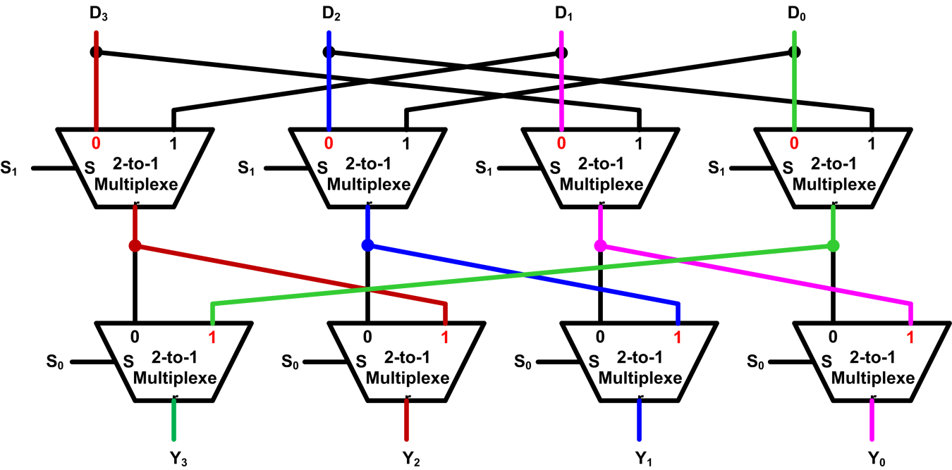
Implementation of Barrel Shifter
Example: S₁S₀ = 01
S₁ | S₀ | Y₃ | Y₂ | Y₁ | Y₀
0 | 0 | D₃ | D₂ | D₁ | D₀
0 | 1 | D₀ | D₃ | D₂ | D₁
1 | 0 | D₁ | D₀ | D₃ | D₂
1 | 1 | D₂ | D₁ | D₀ | D₃
Example four-bit Barrel shifter that performs rotate right

Slide 29
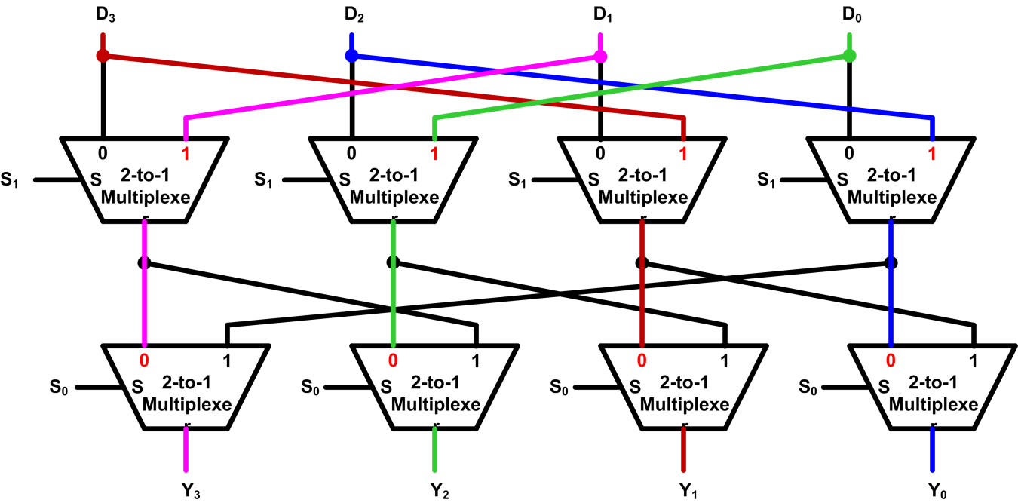
Implementation of Barrel Shifter
Example: S₁S₀ = 10
S₁ | S₀ | Y₃ | Y₂ | Y₁ | Y₀
0 | 0 | D₃ | D₂ | D₁ | D₀
0 | 1 | D₀ | D₃ | D₂ | D₁
1 | 0 | D₁ | D₀ | D₃ | D₂
1 | 1 | D₂ | D₁ | D₀ | D₃
Example four-bit Barrel shifter that performs rotate right

Slide 30
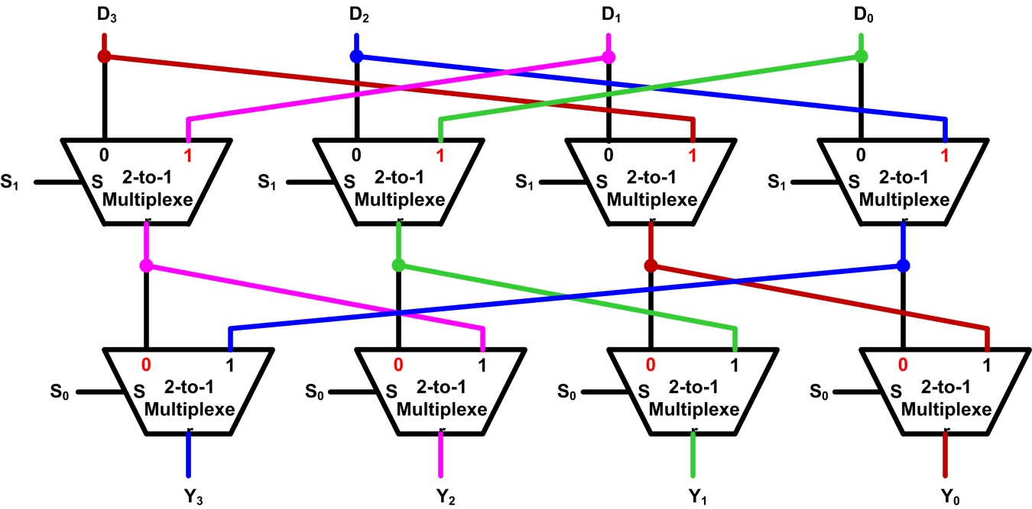
Implementation of Barrel Shifter
Example: S₁S₀ = 11
S₁ | S₀ | Y₃ | Y₂ | Y₁ | Y₀
0 | 0 | D₃ | D₂ | D₁ | D₀
0 | 1 | D₀ | D₃ | D₂ | D₁
1 | 0 | D₁ | D₀ | D₃ | D₂
1 | 1 | D₂ | D₁ | D₀ | D₃
Example four-bit Barrel shifter that performs rotate right

Slide 31
Barrel Shifter
Examples:
ADD r1, r0, r0, LSL #3
; r1 = r0 + r0 << 3 = r0 + 8 × r0
ADD r1, r0, r0, LSR #3
; r1 = r0 + r0 >> 3 = r0 + r0/8 (unsigned)
ADD r1, r0, r0, ASR #3
; r1 = r0 + r0 >> 3 = r0 + r0/8 (signed)
Use Barrel shifter to speed up the application
ADD r1, r0, r0, LSL #3 <=> MOV r2, #9 ; r2 = 9
MUL r1, r0, r2 ; r1 = r0 * 9

Slide 32
Reference:
Embedded Systems with ARM Cortex-M Microcontrollers in Assembly Language and C
Dr. Yifeng Zhu Electrical and Computer Engineering University of Maine

